Slide 1
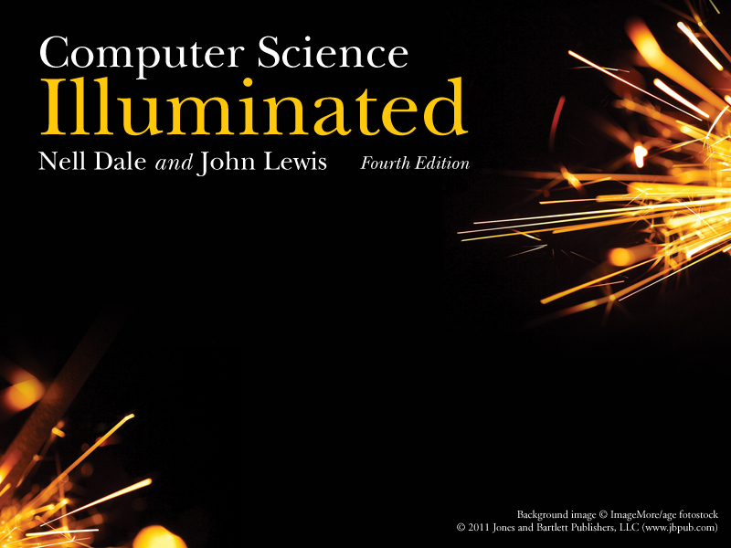
Chapter 4
Gates and Circuits

Slide 2
Chapter Goals
Identify the basic gates(邏輯閘) and describe the behavior (行為) of each
Describe how gates are implemented (實作) using transistors (電晶體)
Combine basic gates into circuits (電路)
Describe the behavior of a gate or circuit using Boolean expressions (布林運算式), truth tables (真值表), and logic diagrams (邏輯圖)

Slide 3
Chapter Goals
Compare and contrast a half adder (半加法器)
and a full adder (全加法器)
Describe how a multiplexer (多工器) works
Explain how an S-R latch (S-R門栓) operates
Describe the characteristics (特性) of the four generations (世代) of integrated circuits (積體電路)

Slide 4
Computers and Electricity
Gate
A device (裝置) that performs (完成) a basic operation on electrical (電子) signals (訊號)
Circuits
Gates combined to perform more
complicated (複雜的) tasks

Slide 5
Computers and Electricity
How do we describe the behavior of gates and circuits?
Boolean expressions
Uses Boolean algebra (代數), a mathematical (數學) notation (表示法) for expressing two-valued logic
Logic diagrams
A graphical (圖形化的) representation (表示法) of a circuit; each gate has its own symbol (符號)
Truth tables
A table showing all possible input value and the associated (聯結的) output values

Slide 6
Gates
Six types of gates
  NOT
  AND
  OR
  XOR
  NAND
  NOR
Typically, logic diagrams are black and white with gates distinguished only by their shape
We use color for emphasis (and fun)

Slide 7
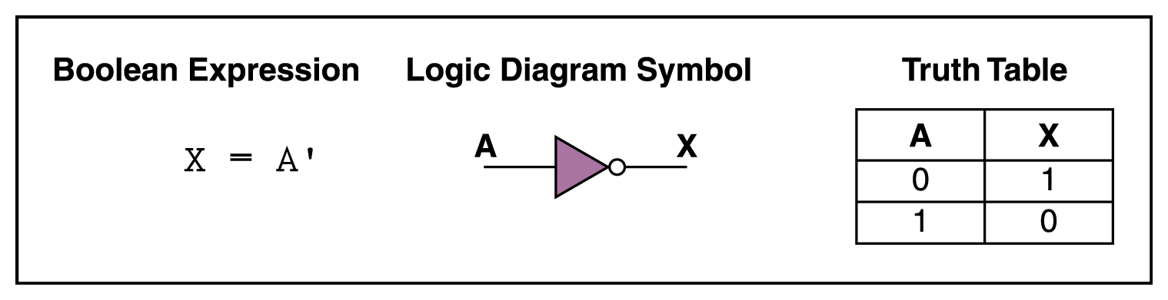
NOT Gate
A NOT gate accepts one input signal (0 or 1) and returns the opposite signal as output
Figure 4.1 Various representations of a NOT gate

Slide 8
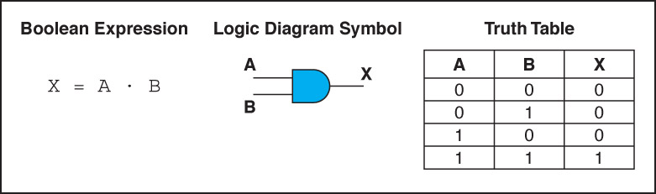
AND Gate
An AND gate accepts two input signals
If both are 1, the output is 1; otherwise,
the output is 0
Figure 4.2 Various representations of an AND gate

Slide 9
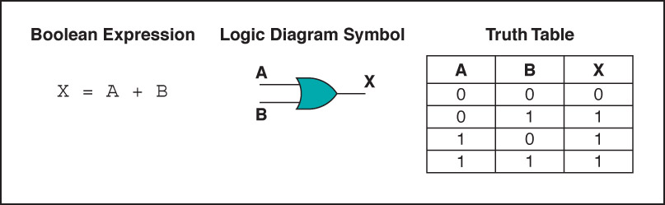
OR Gate
An OR gate accepts two input signals
If both are 0, the output is 0; otherwise,
the output is 1
Figure 4.3 Various representations of a OR gate

Slide 10
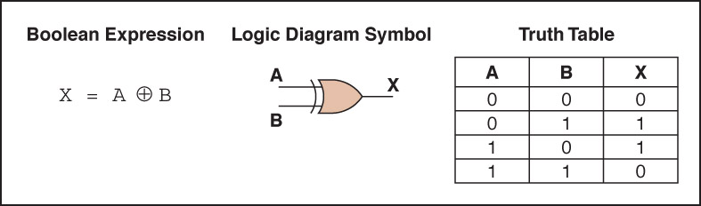
XOR Gate
An XOR gate accepts two input signals
If both are the same, the output is 0; otherwise,
the output is 1
Figure 4.4 Various representations of an XOR gate

Slide 11
XOR Gate
Note the difference between the XOR gate
and the OR gate; they differ only in one
input situation
When both input signals are 1, the OR gate produces a 1 and the XOR produces a 0
XOR is called the exclusive OR

Slide 12
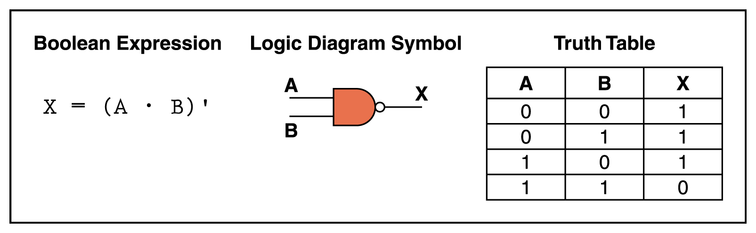
NAND Gate
The NAND gate accepts two input signals
If both are 1, the output is 0; otherwise,
the output is 1
Figure 4.5 Various representations of a NAND gate

Slide 13
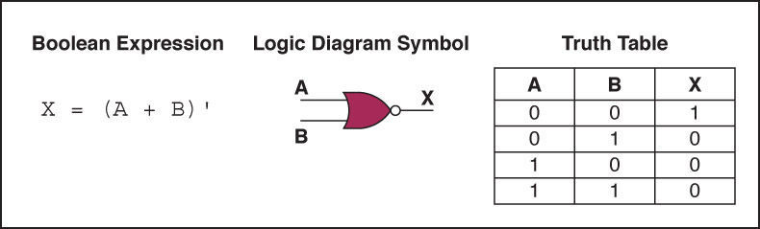
NOR Gate
The NOR gate accepts two input signals
If both are 0, the output is 1; otherwise,
the output is 0
Figure 4.6 Various representations of a NOR gate

Slide 14
Review of Gate Processing
A NOT gate inverts its single input
An AND gate produces 1 if both input values are 1
An OR gate produces 0 if both input values are 0
An XOR gate produces 0 if input values are the same
A NAND gate produces 0 if both inputs are 1
A NOR gate produces a 1 if both inputs are 0

Slide 15
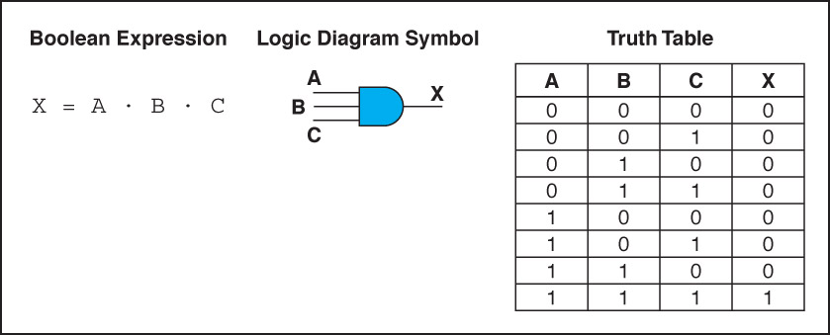
Gates with More Inputs
Gates can be designed to accept three or more input values
A three-input AND gate, for example, produces an output of 1 only if all input values are 1
Figure 4.7 Various representations of a three-input AND gate

Slide 16
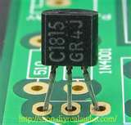
Constructing Gates
Transistor (電晶體)
A device that acts either as a wire that conducts electricity (導電) or as a resistor(電阻) that blocks the flow of electricity, depending on the voltage (電壓) level of an input signal
A transistor has no moving parts, yet acts like
a switch (開關)
It is made of a semiconductor(半導體) material, which is neither a particularly good conductor (導體) of electricity nor a particularly good insulator(絕緣體)

Slide 17
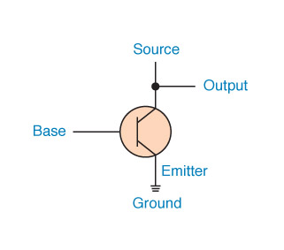
Constructing Gates
A transistor has three terminals
  A source
  A base
  An emitter(發射極), typically connected to a ground wire
If the electrical signal is grounded, it is allowed to flow through an alternative route to the ground (literally) where it can do no harm
Figure 4.8 The connections of a transistor
microSDHC記憶卡尺寸約為指甲大小，卻有超過500億顆的電晶體

Slide 18
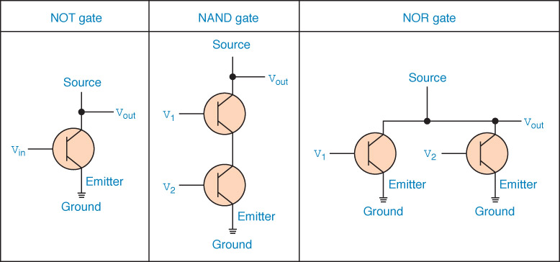
Constructing Gates
The easiest gates to create are the NOT, NAND, and NOR gates
Figure 4.9 Constructing gates using transistors

Slide 19
Circuits
Combinational circuit(組合電路)
The input values explicitly determine (決定) the output
Sequential circuit(循序電路)
The output is a function of the input values and the existing state of the circuit
We describe the circuit operations using
  Boolean expressions
  Logic diagrams
  Truth tables
Are you surprised?

Slide 20
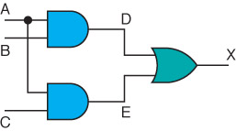
Combinational Circuits
Gates are combined into circuits by using the output of one gate as the input for another

Slide 21
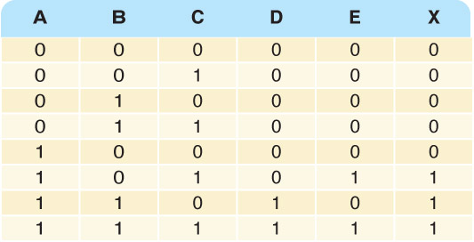
Combinational Circuits
AB
AC
AB+AC
Three inputs require eight rows to describe all possible input combinations
This same circuit using a Boolean expression is (AB + AC)

Slide 22
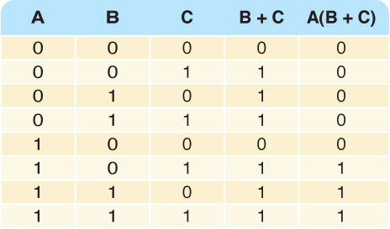

Combinational Circuits
Consider the following Boolean expression A(B + C)
Does this truth table look familiar?
Compare it with previous table

Slide 23
Combinational Circuits
Circuit equivalence (等效電路)
Two circuits that produce the same output for identical (完全相同的) input
Boolean algebra allows us to apply provable (可證明的) mathematical principles (原理) to help design circuits
A(B + C) = AB + AC (distributive law(分配律) ) so circuits must be equivalent

Slide 24
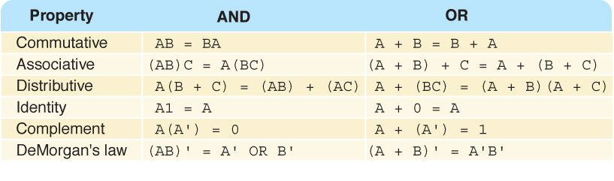
Properties of Boolean Algebra

Slide 25
Adders
At the digital logic level, addition is performed in binary
Addition operations are carried out
by special circuits called, appropriately, adders

Slide 26
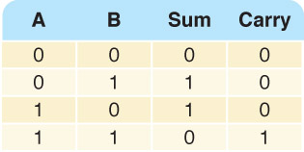
Adders
The result of adding two binary digits could produce a carry(進位) value
Recall that 1 + 1 = 10
in base two
Half adder
A circuit that computes the sum of two bits
and produces the correct carry bit
Truth table

Slide 27
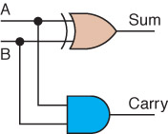
Adders
Circuit diagram representing
a half adder
Boolean expressions
sum = A ⊕ B
carry = AB

Slide 28
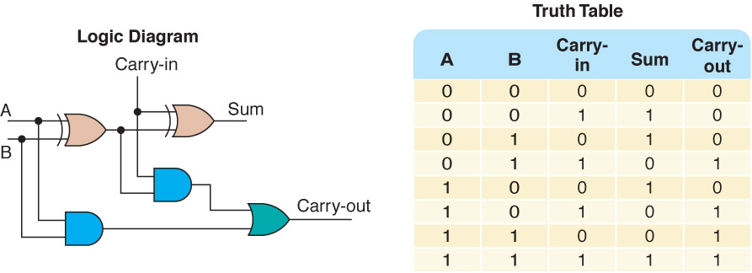
Adders
Full adder
A circuit that takes the carry-in value into account
Figure 4.10 A full adder

Slide 29
Multiplexers
Multiplexer (多工器)
A circuit that uses a few input control signals to determine which of several input data lines is routed to its output

Slide 30
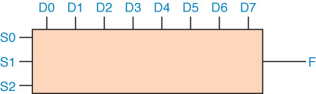
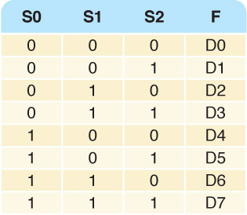
Multiplexers
The control lines S0, S1, and S2
determine which of eight other input lines (D0 … D7)
are routed to the output (F)
Figure 4.11 A block diagram of a multiplexer with three select control lines

Slide 31
Circuits as Memory
Digital circuits can be used to store information
These circuits form a sequential circuit, because the output of the circuit is also used as input to the circuit

Slide 32
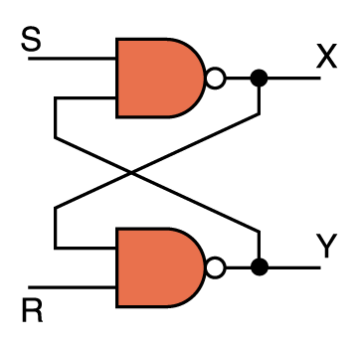
Circuits as Memory
An S-R latch(門栓) stores a single binary digit
(1 or 0)
There are several ways an S-R latch circuit can be designed using various kinds of gates
Figure 4.12 An S-R latch

Slide 33
Circuits as Memory
The design of this circuit guarantees (保證) that the two outputs X and Y are always complements(互補) of each other
The value of X at any point in time is considered to be the current state of the circuit
Therefore, if X is 1, the circuit is storing a 1; if X is 0, the circuit is storing a 0
Figure 4.12 An S-R latch

Slide 34
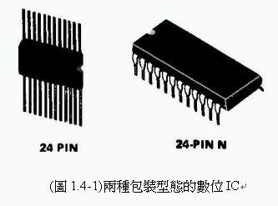
Integrated Circuits
Integrated circuit (also called a chip (晶片) )
A piece of silicon(矽) on which multiple gates have been embedded
Silicon pieces are mounted on a plastic (塑膠) or ceramic (陶瓷) package (封裝) with pins (針腳) along the edges that can be soldered (焊接) onto circuit boards or inserted into appropriate sockets (插座)

Slide 35
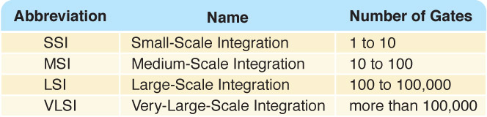
Integrated Circuits
Integrated circuits (IC) are classified by the number of gates contained in them

Slide 36
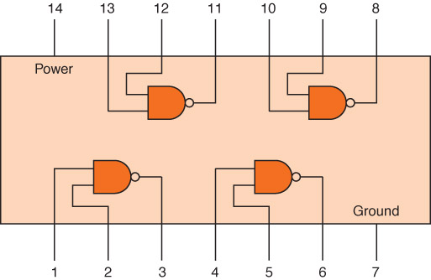
Integrated Circuits - SSI
Figure 4.13 An SSI chip contains independent NAND gates

Slide 37
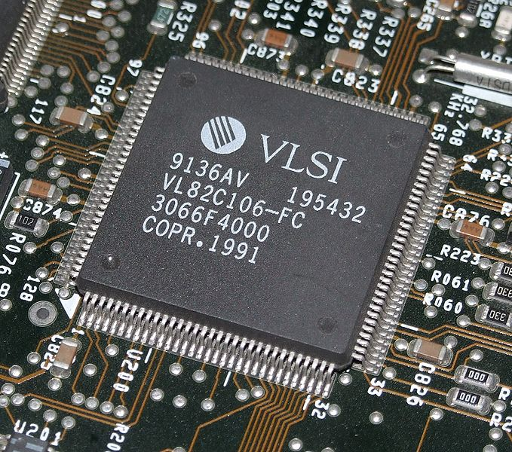
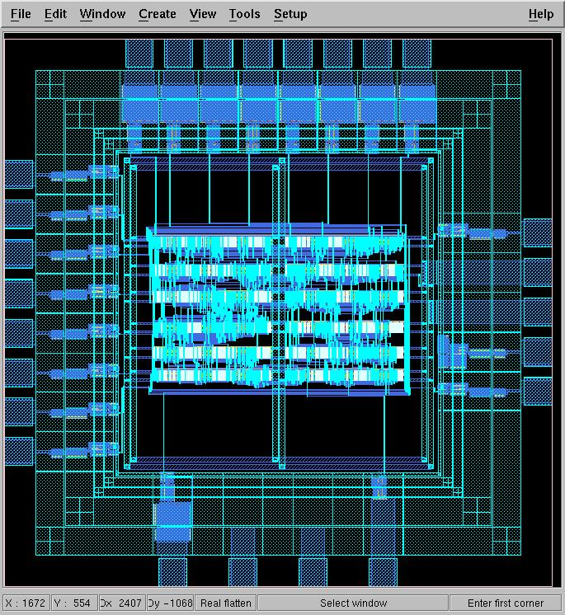
Integrated Circuits - VLSI

Slide 38
CPU Chips
The most important integrated circuit
in any computer is the Central Processing Unit, or CPU
Each CPU chip has a large number of pins through which essentially all communication (通訊) in a computer system occurs

Slide 39
Ethical Issues
Email Privacy
Explain why privacy is an illusion.
Who can read your email?
Do you send personal email from work?
Does everyone in your family use email?

Slide 40
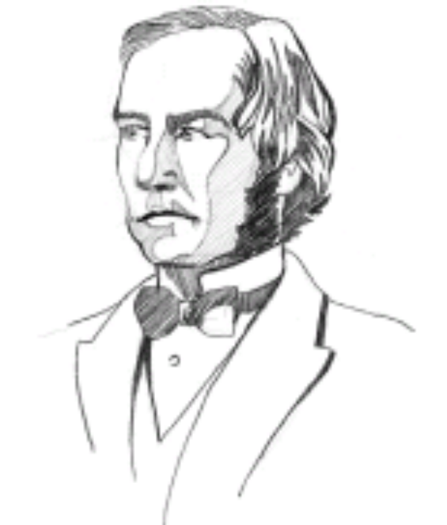
Who am I?
All the world knows my name. What is
it and why do people know it?

Slide 41

Do you know?
What is the name of the study of materials
smaller than 100 nanometers?
Did DeMorgan discover DeMorgan's laws?
How do archeologists use GPS systems?
What's wrong with uploading your photos
to a social networking site?

